Slide 1


DATABASE

Slide 2


Introducing SQLite
SQLite is a well regarded relational database management system (RDBMS). It is:
Open-source
Standards-compliant
Lightweight
Single-tier

Slide 3
ContentValues
ContentValues are used to insert new rows into tables. Each Content Values object represents a single table row as a map of column names to values.

Slide 4
Queries in Android are returned as Cursor objects. Rather than extracting and returning a copy of the result values, Cursors are pointers to the result set within the underlying data. Cursors provide a managed way of controlling your position (row) in the result set of a database query.
The Cursor class includes a number of navigation functions including, but not limited to, the following:
moveToFirst - Moves the cursor to the first row in the query result
moveToNext - Moves the cursor to the next row
moveToPrevious - Moves the cursor to the previous row
getCount - Returns the number of rows in the result set
getColumnIndexOrThrow - Returns the index for the column with the specified name (throwing an exception if no column exists with that name)
getColumnName - Returns the name of the specified column index
getColumnNames - Returns a string array of all the column names in the current Cursor
moveToPosition - Moves the Cursor to the specified row
getPosition - Returns the current Cursor position

Slide 5
SQLiteOpenHelper
SQLiteOpenHelper is an abstract class used to implement the best practice pattern for creating, opening, and upgrading databases. By implementing an SQLite Open Helper you hide the logic used to decide if a database needs to be created or upgraded before it’s opened.
You extend the SQLiteOpenHelper class by overriding the constructor, onCreate, and onUpgrade methods to handle the creation of a new database and upgrading to a new version, respectively.

Slide 6

Using the SQLiteOpenHelper to access a database
To use an implementation of the helper class, create a new instance, passing in the context, database name, and current version, and a CursorFactory (if you’re using one).
Call getReadableDatabase or getWritableDatabase to open and return a readable/writable instance of the underlying database.
dbHelper = new myDbHelper(context, DATABASE_NAME, null,DATABASE_VERSION);
SQLiteDatabase db;
try {
db = dbHelper.getWritableDatabase();
}
catch (SQLiteException ex){
db = dbHelper.getReadableDatabase();
}

Slide 7
Setting the Table
For creating your tables and indexes, you will need to call execSQL() on your SQLiteDatabase, providing the DDL statement you wish to apply against the database. Barring a database error, this method returns nothing.
So, for example, you can use the following code:
db.execSQL("CREATE TABLE constants (_id INTEGER PRIMARY KEY AUTOINCREMENT, title TEXT, value REAL);");

Slide 8
Given that you have a database and one or more tables, you probably want to put some data in them and such. You have two major approaches for doing this.
You can always use execSQL(), just like you did for creating the tables. The execSQL() method works for any SQL that does not return results, so it can handle INSERT, UPDATE, DELETE, etc. just fine. So, for example you could use this code:
db.execSQL("INSERT INTO students (name, course)"+
"VALUES (‘Alvin', ‘BSIT’);
Your alternative is to use the insert(),update(), and delete() methods on the SQLiteDatabase object. These are “builder” sorts of methods, in that they break down the SQL statements into discrete chunks, then take those chunks as parameters.

Slide 9
Querying a Database
Each database query is returned as a Cursor. This lets Android manage resources more efficiently by retrieving and releasing row and column values on demand.
To execute a query on a database use the query method, passing in:
An optional Boolean that specifies if the result set should contain only unique values.
The name of the table to query.
A projection, as an array of strings, that lists the columns to include in the result set.
A ‘‘where’’ clause that defines the rows to be returned. You can include ? wildcards that will
be replaced by the values passed in through the selection argument parameter.
An array of selection argument strings that will replace the ?’s in the where clause.
A ‘‘group by’’ clause that defines how the resulting rows will be grouped.
A ‘‘having’’ filter that defines which row groups to include if you specified a group by clause.
A string that describes the order of the returned rows.
An optional string that defines a limit for the number of returned rows.

Slide 10
Querying a Database
// Return all rows for columns one and three, no duplicates
String[] result_columns = new String[] {KEY_ID,
KEY_COL1, KEY_COL3};
Cursor allRows = myDatabase.query(true, DATABASE_TABLE,
result_columns,null, null, null, null,
null, null);
// Return all columns for rows where column 3 equals a set value
// and the rows are ordered by column 5.
String where = KEY_COL3 + "=" + requiredValue;
String order = KEY_COL5;
Cursor myResult = myDatabase.query(DATABASE_TABLE, null,
where,null, null, null, order);

Slide 11
Extracting Results from a Cursor
To extract values from a result Cursor, first use the moveTo<location> methods described earlier to position the cursor at the correct row of the result Cursor.
Then use the type safe get<type> methods (passing in a column index) to return the value stored at the current row for the specified column, as shown below:
String columnValue = myResult.getString(columnIndex);

Slide 12
Extracting Results from a Cursor
int GOLD_HOARDED_COLUMN = 2;
Cursor myGold = myDatabase.query("GoldHoards", null,
null, null, null, null, null);
float totalHoard = 0f;
// Make sure there is at least one row.
if (myGold.moveToFirst()) {
// Iterate over each cursor.
do {
float hoard = myGold.getFloat(GOLD_HOARDED_COLUMN);
totalHoard += hoard;
} while(myGold.moveToNext());
}
float averageHoard = totalHoard / myGold.getCount();
This example shows how to iterate over a result Cursor, extracting and summing a column of float values.

Slide 13
Inserting New Rows
To create a new row, construct a ContentValues object and use its put methods to provide a value for each column. Insert the new row by passing the Content Values object into the insert method called on the target database — along with the table name as shown below:
// Create a new row of values to insert.
ContentValues newValues = new ContentValues();
// Assign values for each row.
newValues.put(COLUMN_NAME, newValue);
[ ... Repeat for each column ... ]
// Insert the row into your table
myDatabase.insert(DATABASE_TABLE, null, newValues);

Slide 14
Updating a Row
Updating rows is also done with Content Values.
Create a new ContentValues object, using the put methods to assign new values to each column you want to update. Call update on the database, passing in the table name, the updated Content Values object, and a where clause that specifies the row(s) to update as shown below:
// Define the updated row content.
ContentValues newValues = new ContentValues();
// Assign values for each row.
newValues.put(COLUMN_NAME, newValue);
[ ... Repeat for each column ... ]
String where = KEY_ID + "=" + rowId;
// Update the row with the specified index with the new values.
myDatabase.update(DATABASE_TABLE, newValues, where,
null);

Slide 15
Deleting Rows
To delete a row simply call delete on a database, specifying the table name and a where clause that returns the rows you want to delete as shown below:
myDatabase.delete(DATABASE_TABLE, KEY_ID + "=" + rowId, null);

Slide 16
Query Builder
Yet another option is to use SQLiteQueryBuilder, which offers much richer query-building options, particularly for nasty queries involving things like the union of multiple sub-query results. More importantly, the SQLiteQueryBuilder interface dovetails nicely with the ContentProvider interface for executing queries.
@Override public Cursor query(Uri uri, String[] projection, String selection,
String[] selectionArgs, String sortOrder) {
SQLiteQueryBuilder sqlBuilder = new SQLiteQueryBuilder();
sqlBuilder.setTables(DATABASE_TABLE);
if (uriMatcher.match(uri) == BOOK_ID)
sqlBuilder.appendWhere( _ID + " = " + uri.getPathSegments().get(1));
if (sortOrder==null || sortOrder=="")
sortOrder = TITLE;
Cursor c = sqlBuilder.query(
booksDB,
projection,
selection,
selectionArgs,
null,
null,
sortOrder);
c.setNotificationUri(getContext().getContentResolver(), uri);
return c;
}

Slide 17
Content Provider

Slide 18
Using a Content Provider
In Android, a content provider is a specialized type of data store that exposes standardized ways to retrieve and manipulate the stored data. Android ships with several useful content providers, as shown in Table below:
Content Provider | Intended Data
Browser | Browser bookmarks, browser history, etc.
CallLog | Missed calls, call details, etc.
Contacts | Contact details
MediaStore | Media files such as audio, video and images
Setting | Device settings and preferences

Slide 19
To query a content provider, you provide a query string in the form of a URI, with an optional specifier for a particular row, using the following syntax:
<standard_prefix>://<authority>/<data_path>/<id>
For example, to retrieve all the bookmarks stored by your web browsers (in Android), you would use the following content URI:
content://browser/bookmarks

Slide 20
To retrieve all the contacts stored by the Contacts application, the URI would look like this:
content://contacts/people
To retrieve a particular contact, you can specify the URI with a specific ID:
content://contacts/people/3

Slide 21
The code below accesses the call log of your Android device and prints out all the calls that you have made.
package net.learn2develop.CPExamples;
import android.app.Activity;
import android.database.Cursor;
import android.net.Uri;
import android.os.Bundle;
import android.provider.CallLog.Calls;
import android.util.Log;
public class CPExampleActivity extends Activity {
@Override
public void onCreate(Bundle savedInstanceState) {
super.onCreate(savedInstanceState);
setContentView(R.layout.main);
Uri allCalls = Uri.parse("content://call_log/calls");
Cursor c = managedQuery(allCalls, null, null, null, null);
if (c.moveToFirst()) {
do{
String callType = ""; switch (Integer.parseInt(c.getString( c.getColumnIndex(Calls.TYPE)))) {
case 1: callType = "Incoming"; break;
case 2: callType = "Outgoing"; break;
case 3: callType = "Missed";
}
Log.v("Content Providers", c.getString(c.getColumnIndex(Calls._ID)) + ", " + c.getString(c.getColumnIndex(Calls.NUMBER)) + ", " + callType) ;
} while (c.moveToNext());
}
}
}

Slide 22
You would also need to add in the READ_CONTACTS permission in the AndroidManifest.xml file:
<?xml version="1.0" encoding="utf-8"?>
<manifest xmlns:android= "http://schemas.android.com/apk/res/android" package="net.learn2develop.CPExamples" android:versionCode="1" android:versionName="1.0.0">
<application
android:icon="@drawable/icon" android:label="@string/app_name">
<activity
android:name=".CPExampleActivity" android:label="@string/app_name">
<intent-filter>
<action android:name="android.intent.action.MAIN" />
<category android:name= "android.intent.category.LAUNCHER" />
</intent-filter>
</activity>
</application>
<uses-permission
android:name="android.permission.READ_CONTACTS">
</uses-permission>
</manifest>

Slide 23
Note that the managedQuery() method accepts five arguments:
Cursor c = managedQuery(allCalls, null, null, null, null);
The second argument to the managedQuery() method, known as "projections," controls how many columns the query returns. You can specify exactly which columns the method should return by creating an array containing the name of the desired columns. For example:
String[] projection = new String[] { Calls._ID, Calls.NUMBER, Calls.TYPE}; Cursor c = managedQuery(allCalls, projection, null, null, null);

Slide 24
The third and fourth parameters, known as "Filtering," let you specify a SQL WHERE clause to filter the query results. You can specify a filtering rule as shown below to retrieve numbers beginning with 65:
Cursor c = managedQuery(allCalls, projection, "Calls.NUMBER LIKE '65%'", null, null);
The fifth and last parameter lets you specify a SQL ORDER BY clause to sort the query results. This parameter is also known as "Sorting." You can specify a sorting rule as below to sort result by call TYPE descending:
Cursor c = managedQuery(allCalls, projection, "Calls.NUMBER LIKE '5%'", null, "Calls.TYPE DESC");

Slide 25
Creating Your Own Content Providers
To create your own content provider in Android, all you need to do is to extend the abstract ContentProvider class and override the various methods defined within it.
public class MyContent extends ContentProvider {
@Override public int delete(Uri arg0, String arg1, String[] arg2) {
return 0;
}
@Override public String getType(Uri uri) {
return null;
}
@Override public Uri insert(Uri uri, ContentValues values) {
return null;
}
@Override
public boolean onCreate() {
return false;
}
@Override
public Cursor query(Uri uri, String[] projection, String selection,
String[] selectionArgs, String sortOrder) {
return null;
}
@Override
public int update(Uri uri, ContentValues values, String selection, String[] selectionArgs) {
return 0;
}
}

Slide 26
You'll need to override the getType() method so it uniquely describes the data type for your content provider. Using the UriMatcher object, you will return vnd.android.cursor.item/vnd.learn2develop.books" for a single book, and "vnd.android.cursor.dir/vnd.learn2develop.books" for multiple books:
@Override
public String getType(Uri uri) {
switch (uriMatcher.match(uri)) {
//---get all books---
case BOOKS:
return "vnd.android.cursor.dir/vnd.fel1.books "; //---get a particular book---
case BOOK_ID:
return "vnd.android.cursor.item/vnd.fel1.books ";
default:
throw new IllegalArgumentException("Unsupported URI: " + uri);
}
}
UriMatcher is a convenience class that allows a many-to-one mapping by using pattern matching. The numeric assignment allows one to insert, remove and rearrange patterns without effecting the match.

Slide 27
To allow clients to query for books, override the query() method. The query() method must return a Cursor object that can iterate over the requested data:
@Override
public Cursor query(Uri uri, String[] projection, String selection,
String[] selectionArgs, String sortOrder) {
SQLiteQueryBuilder sqlBuilder = new SQLiteQueryBuilder();
sqlBuilder.setTables(DATABASE_TABLE);
if (uriMatcher.match(uri) == BOOK_ID) //---if getting a particular book---
sqlBuilder.appendWhere( _ID + " = " + uri.getPathSegments().get(1));
if (sortOrder==null || sortOrder=="")
sortOrder = TITLE;
Cursor c = sqlBuilder.query(
booksDB,
projection,
selection,
selectionArgs,
null,
null,
sortOrder);
//---register to watch a content URI for changes---
c.setNotificationUri(getContext().getContentResolver(), uri);
return c;
}
By default, the query result is sorted using the title field. The resulting query is returned as a Cursor object.

Slide 28
Next, override the onCreate() method to open a connection to the database when the content provider is started:
@Override
public boolean onCreate() {
Context context = getContext();
DatabaseHelper dbHelper = new DatabaseHelper(context);
booksDB = dbHelper.getWritableDatabase();
return (booksDB == null)? false:true;
}

Slide 29
To allow new books to be inserted into the content provider, override the insert() method:
@Override
public Uri insert(Uri uri, ContentValues values) {
//---add a new book---
long rowID = booksDB.insert( DATABASE_TABLE, "", values);
//---if added successfully---
if (rowID>0) {
Uri _uri = ContentUris.withAppendedId(CONTENT_URI, rowID); getContext().getContentResolver().notifyChange(_uri, null);
return _uri;
}
throw new SQLException("Failed to insert row into " + uri);
}
After inserting the record successfully, call the Content Resolver's notifyChange() method to notify registered observers that a row was updated.

Slide 30
To delete a book, override the delete() method:
@Override
public int delete(Uri arg0, String arg1, String[] arg2) {
// arg0 = uri // arg1 = selection // arg2 = selectionArgs int count=0;
switch (uriMatcher.match(arg0)){
case BOOKS:
count = booksDB.delete( DATABASE_TABLE, arg1, arg2); break;
case BOOK_ID:
String id = arg0.getPathSegments().get(1);
count = booksDB.delete( DATABASE_TABLE, _ID + " = " + id + (!TextUtils.isEmpty(arg1) ? " AND (" + arg1 + ')' : ""), arg2);
break;
default:
throw new IllegalArgumentException( "Unknown URI " + arg0);
}
getContext().getContentResolver().notifyChange(arg0, null); return count;
}
You also need to call the Content Resolver's notifyChange()method after the deletion to notify registered observers that a row was deleted.

Slide 31
Finally, to update a book, override the update() method:
@Override
public int update(Uri uri, ContentValues values, String selection, String[] selectionArgs) {
int count = 0;
switch (uriMatcher.match(uri)){
case BOOKS:
count = booksDB.update( DATABASE_TABLE, values, selection, selectionArgs);
break;
case BOOK_ID:
count = booksDB.update( DATABASE_TABLE, values, _ID + " = " + uri.getPathSegments().get(1) + (!TextUtils.isEmpty(selection) ? " AND (" + selection + ')' : ""), selectionArgs);
break;
default:
throw new IllegalArgumentException( "Unknown URI " + uri);
}
getContext().getContentResolver().notifyChange(uri, null);
return count;
}
Again, call notifyChange() to let registered observers know that a row was updated.

Slide 32
Declaring the content provider
To let the Android system know about the content provider you've developed, declare it with a <provider> element in the application's AndroidManifest.xml file. Content providers that are not declared in the manifest are not visible to the Android system
The name attribute is the fully qualified name of the ContentProvider subclass. The authorities attribute is the authority part of the content: URI that identifies the provider. For example if the ContentProvider subclass is AutoInfoProvider, the <provider> element might look like this:
<provider android:name="MyContent"
android:authorities="com.fel1.provider.Books“ />
Note that the authorities attribute omits the path part of a content: URI.

Slide 33
Using the Books Content Provider
With the new content provider completed, you can test it. Start by adding two books into the content provider in the CPExampleActivity.java file:
//---add a book---
ContentValues values = new ContentValues();
values.put(BooksProvider.TITLE, “Beginning Rails: From Novice to Professional"); values.put(BooksProvider.ISBN, “1590596862");
Uri uri = getContentResolver().insert( BooksProvider.CONTENT_URI, values);
//---add another book---
values.clear(); values.put(BooksProvider.TITLE, “CSS, DHTML & AJAX");
values.put(BooksProvider.ISBN, “032144325X");
uri = getContentResolver().insert( BooksProvider.CONTENT_URI, values);
Here we need to understand the ContentResolver class. A ContentResolver provides applications access to the content data / model. We can get a handle to a ContentResolver by calling the getContentResolver() method within the Activity. This provides methods to insert, update and delete data. In order to insert data, we need to provide it through a ContentValues object.

Slide 34
To prove that the two books were added correctly, create a query and then print out each book's ID, title and ISBN using the Toast class:
Uri allTitles = Uri.parse( "content://com.fel1.provider.Books/books");
Cursor c = managedQuery(allTitles, null, null, null, "title desc");
if (c.moveToFirst())
{ do
{
Toast.makeText(this, c.getString(c.getColumnIndex( BooksProvider._ID)) + ", " + c.getString(c.getColumnIndex( BooksProvider.TITLE)) + ", " + c.getString(c.getColumnIndex( BooksProvider.ISBN)), Toast.LENGTH_LONG).show();
} while (c.moveToNext());
}
The preceding query will return results by title sorted in descending order.

Slide 35
To update a book's details, call the update() method using a content URI that indicates the book's ID:
ContentValues editedValues = new ContentValues(); editedValues.put(BooksProvider.TITLE, "Programming Sudoku (Apress)");
getContentResolver().update( Uri.parse("content://com.fel1.provider.Books/books/2"), editedValues, null, null);

Slide 36
Use a similar content URI to delete a book:
getContentResolver().delete(
Uri.parse( "content://com.fel1.provider.Books/books/2"), null, null);
To delete all books, simply omit the book's ID in your content URI:
getContentResolver().delete(
Uri.parse( "content://com.fel1.provider.Books/books"), null, null);

Slide 37
LOCALIZATION

Slide 38
How to Create Alternative Resources
A large part of localizing an application is providing alternative text for different languages. In some cases you will also provide alternative graphics, sounds, layouts, and other locale-specific resources.
An application can specify many res/<qualifiers>/ directories, each with different qualifiers. To create an alternative resource for a different locale, you use a qualifier that specifies a language or a language-region combination. (The name of a resource directory must conform to the Android resource naming scheme or else it will not compile.)

Slide 39
Suppose that your application's default language is English. Suppose also that you want to localize all the text in your application to French, and most of the text in your application (everything except the application's title) to Japanese. In this case, you could create three alternative strings.xml files, each stored in a locale-specific resource directory:
res/values/strings.xml
Contains English text for all the strings that the application uses, including text for a string named title.
res/values-fr/strings.xml
Contain French text for all the strings, including title.
res/values-ja/strings.xml
Contain Japanese text for all the strings except title.
If your Java code refers to R.string.title, here is what will happen at runtime:
If the device is set to any language other than French, Android will load title from the res/values/strings.xml file. If the device is set to French, Android will load title from the res/values-fr/strings.xml file.

Slide 40
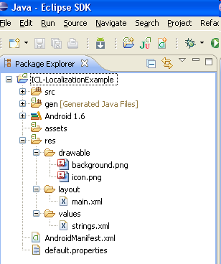
Here is a sample application to better understand the localization process. This is a very simple single-language application which displays a country’s flag and a text view according to the language set in the device. The structure of the project will be as shown below:
The application doesn’t check the user’s locale and always executes the same, for any locale setting

Slide 41
The next step towards localizing is to plan the way the app should display differently for different locales. We’ll add locale-specific information for Italy, France, Canada. The table below details the different display options for different locales.
Region/Language | US | Philippines | France | Canada | Other Location
English | US Flag + English Text |  |  | Canadian Flag + English Text
Tagalog |  | Philippine Flag + Tagalog Text
French |  |  | French Flag + French Text | Canadian Flag + French Text
Other Languages |  |  |  |  | Default Image + English text

Slide 42
Table showing the paths to the different resource files and which ones are used for which locale.
Locale Code | Language/Country | Location of Strings | Location of Images
default | default | res/values/ | res/drawable/
en-rUS | US | res/values/ | res/drawable-en-rUS /
fr-rFR | France | res/values-fr/ | res/drawable-fr-rFR /
en-rCA | English/Canada | res/values/ | res/drawable-en-rCA/
fr-rCA | French/Canada | res/values-fr/ | res/drawable-fr-rCA/
tl-rPH | Philippines | res/values-tl/ | res/drawable-tl-rPH/

Slide 43
Translating Strings
The application requires three strings.xml files, one for each in English, French, and Tagalog.
The procedure for creating strings.xml files is as follows:
Translate the strings.xml file to each language.
Create two new folders under res –values-fr and values-tl (The original values folder already exists).
Place the translated strings.xml files in the respective folders.

Slide 44
Localizing Images
The application needs five more drawable folders, each containing a variant of the background image.
Place background image that has to appear for a respective language in corresponding folders under the project workspace of the sample application.

Slide 45
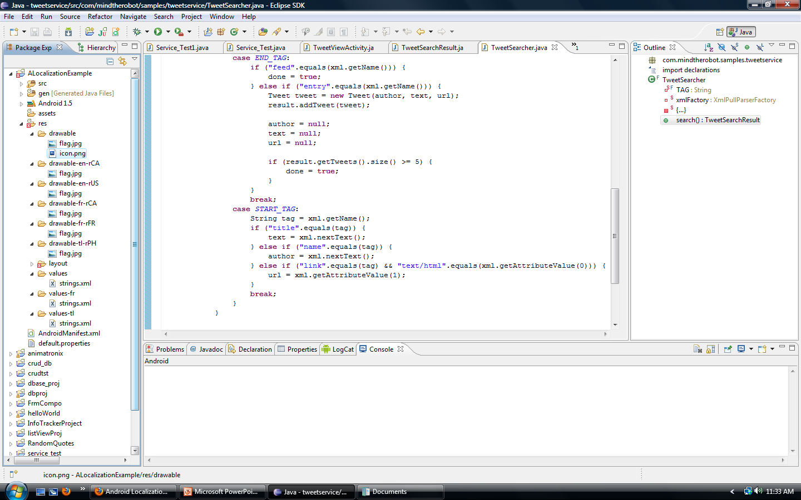
After you save the strings.xml and background image files in their target folders, the project workspace looks like this:

Slide 46
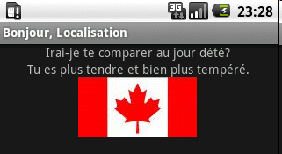
Running and Testing the Localized Application
Once the localized string and image resources are added to the project workspace, the application is ready for testing. To test it, we can set different locales via Home > Menu > Settings > Locale & text > Select locale.
An example of the expected results that we should see after setting the region and language in the phone.

Slide 47
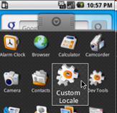
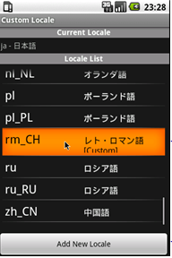
To set the emulator to a locale that is not available in the system image, use the Custom Locale application, which is available in the Application tab:
To switch to a new locale, long-press a locale name:
Long press to switch to this locale
Use Add New Locale to create a custom locale

